Slide 1
The Basics to Programming 2
A Series of Bite Size Lessons for Programming​
Lesson 2: Variables and If Statements
By Tariq Chatur

Slide 2
Introduction
Now that you have completed Lesson 1, you should have a basic understanding of how to print to the console and numbers in code. You will be using both in every step of this lesson.
The topics in this lesson are likely going to the foundation of anything you code for the rest of your life
Variables are key to manipulating values for repeated use
If Statements require you to have an understanding of basic logic
These two features will be used in almost all of the future lessons so by the end of this you will have a fairly strong understanding of how they work

Slide 3
Variables
Variables are how we store information in code to be called later on. These values are stored with a name to be called by and can be manipulated.
In PowerShell, variables are denoted with the $ symbol.
eg. $name = “Tariq”
*Standard Name Conventions start variables with lowercase letters and use Uppercase letters to symbolise spaces.
eg. $numberOfEggs = 3
**For the sake of other programmers please use names that describe the use of the variable.
eg. Do Not Do This
$a = 2
$b = 1
$c = “Wednesday”

Slide 4


Hello World - Variable Version
Now we will create a script that will use a variable.
This will be a version of Hello World, which means that we will just print out the words Hello World.
We will save the “Hello World” String in a variable and call that variable in the Write-Host call.
Please copy this code and run it to see if you get the same output.

Slide 5
Review of Hello World Example
$Name : Saves the value of whatever is assigned to it regardless of type for later use. This is called a Variable.
*PowerShell will automatically determine the type of the variable, but in many other languages, the type needs to be defined in the initialisation of the variable
This is important because, we can save important or dynamic information into variables to save time with coding, pass values between methods, or reference values that are constantly changing.
More cases of using Variables are on the next slide

Slide 6
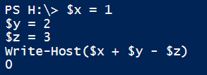
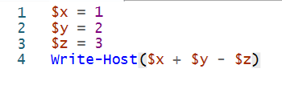





More Examples of Variables
Using more than one Variable
Overwriting a variable with new values
Using the same variable more than once
Using Variables to make Variables

Slide 7
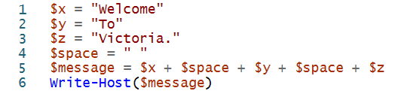
Variable Exercise
Make a script that prints a sentence of your choice (minimum 3 words).
Restrictions:
- You can only have one Write-Host command which is:
Write-Host($message)
You can only store maximum one word per variable
$message can only be constructed from other variables
Answer
Drag Answer Box Here to see Answer

Slide 8
Value Comparison Quick Review I
When writing programs, a great deal of decisions depend of the comparison of values.
The values to learn if you are not familiar are: True, False, Equal, Greater, Less, And, Or, and Not
When comparing values we are looking to see if the left hand side of a statement is equal to the right hand side. The left being the current value and the right being a condition.
Example:
If the oven preheat light is off, put the cake in the oven.
In this example we want to break it into the current state, the condition of this statement, and the resulting action.
Left Side – The Current State
Right Side – The Condition
Resulting Action – The Condition
The current state of the preheat light
The preheat light is off
Put the Cake in the Oven
In programming we need to convert this logical statement into our language so we can make different choices based on the context of the comparison.

Slide 9
Value Comparison Quick Review II
Left Side – The Current State
Right Side – The Condition
Resulting Action – The Condition
The current state of the preheat light
The preheat light is off
Put the Cake in the Oven
Now we make the logical statement that will connect these states.
As per the example:
If the oven preheat light is off, put the cake in the oven.
Therefore:
If the Left side is Equal to the Right side we want to do the action.
and
If the Left side doesn’t equal the right side we want to do nothing, or maybe wait and check again. (Depends on the context of the statement)
Usually the conditions aren’t this straight forward but this is the basis of all IF statements.

Slide 10
Value Comparison Quick Review III
So to overview:
When we compare values we want to say,
“If A is B then do C”
A : A premise, current state, or dynamic value
B : The condition to do an action
C : The resulting action
These can also be combined or nested if need be. Which will be showcased in the next section.

Slide 11
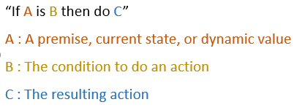

If Statements
The standard way to write an If statement is like this:
In code what this means is:
If A is equal to B, then do whatever is within the brackets. This introduces the concept of Scope which I will speak about prior to the exercise
With If Statements, the code will do whatever is in the {} for the IF statement that matches
So lets move onto an example of using an IF statement.

Slide 12
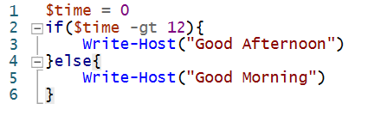

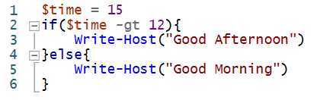

If statement example
To use an If statement we need something to compare. In this case we can make a variable called $Time which will be our dynamic variable.
Our goal is to print Good Morning or Good Afternoon Depending on the time of day.
In this example we will just work with the hours in a 24 hour clock.

Slide 13
Review of If Statement Example
False
Good Morning
$time
>12
Good Afternoon
True
If(…){ A }else{ B }:
This is a conditional statement. After evaluating the logical statement(…), if the statement is TRUE it will execute A. If it is FALSE it will execute B.
-gt : This is the logical operator for Greater Than.
*There will be a table on the next page with the most common logical operators.
On the right side of the code you can see the UML (Unified Modeling Language) representation of the if statement. While this is useful with visualisation, we often run into the issue that the visualisations are harder to understand than the code itself for complex systems. The use of UML is up to you when presenting your code. I will only include it when I believe it will more easily model the system.

Slide 14
Logical Operators
If you need additional logical or comparison operators go to this site
These are things you can always look up, over time you will use them and remember them.
I wouldn’t recommend spending too much trying to remember them.
A –eq B | If A is equal to B
A –gt B | If A is greater than to B *
A –ge B | If A is greater than or equal to B *
A –lt B | If A is less than to B *
A –le B | If A is less than or equal to B *
A –ne B | If A is not equal to B
A –and B | If statement A is True And statement B is True
A –or B | If statement A is True Or statement B is True
*Normally used when comparing numbers

Slide 15
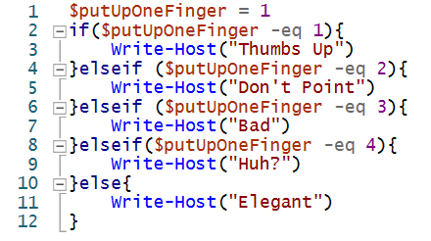
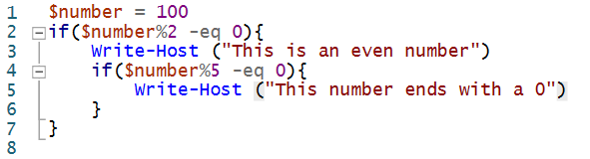
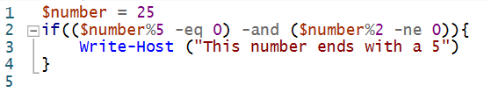
More Examples of If Statements
Consecutive If statements
Nested If statements
More than one statement in an if statement

Slide 16
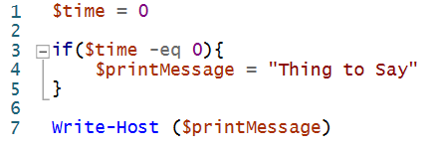
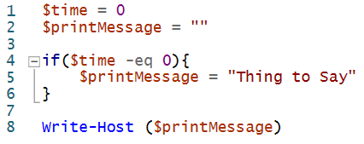
Scope
Scope is the limitation on visibility of code. The main culprit of Scope is the {} symbols.
We will look at this principle through an example:
In this example we will get an ERROR because
the variable $printMessage doesn’t exist outside of the
{} that surround it.
If you want values to change to be created in a set of {} then you need to initialise it outside of the {}. When it comes to Scope, values outside of the {} can be called from inside the {}, but not the other way around.
This becomes much more important when we introduce
methods in later lessons.
BAD CODE
*PowerShell auto sets values in global scope, but this is bad coding practice as it will not work in most languages
GOOD CODE

Slide 17
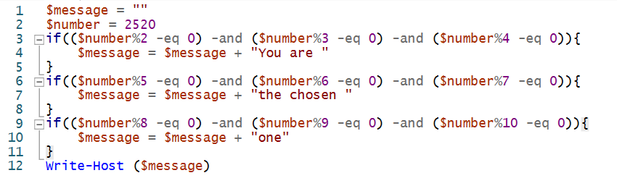
If Statement Exercise
Hint
The Chosen Number: 2520
Make a script that takes in a $number and prints values based on whether it can be divisible by another number.
If the number can be divided evenly by 2, 3, and 4 make the system print “You are”
If the number can be divided evenly be 5, 6, and 7 make the system print “the chosen”
If the number can be divided evenly by 8, 9, and 10 make the system print “one”
*These conditions are mutually exclusive, so you don’t need to make “Else” sections, just sequential IF statements will be enough
Answer

Slide 18
Lesson Review
In this lesson you learned about Variables and If Statements. These two topics will be used in every topic going forward. So overtime you will get more familiar with them and how to use them optimally.
Variables are denoted with the $ symbol. They store values to be referred later in the code. These are also key to hold information like user input.
If statements are where computers gain the ability to make decisions. If statements use logic and comparators to determine which set of code to run. These are the basis for allowing code to do more than one action based on the context of the situation
Scope determines the visibility of information in code. Scope will be expanded on as we continue to move into future lessons.

Slide 19
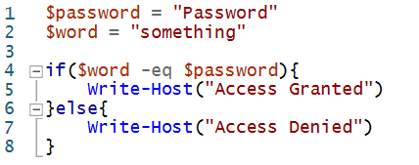
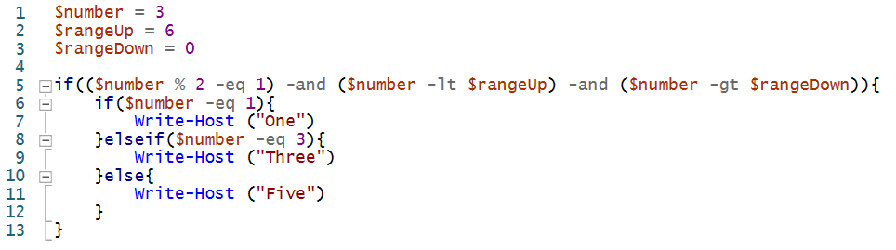
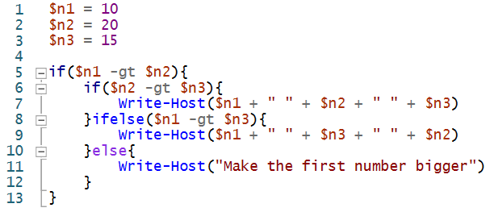
Review Exercises I
Take the prompt and write a program for it
Prompt
Example Solution
Answer
Level 1:
Takes a word as input. If the word is equal to “Password” then print “Access Granted”, otherwise print “Access Denied”
Level 2:
Takes a number if it is an odd number between 0 and 6, spell the number using the alphabet
Answer
Level 3:
Takes three numbers and prints them in ascending order. It doesn’t matter what order they print for numbers that are equal.
- If the first number isn’t the biggest, print “Make the first number bigger”
Answer

Slide 20


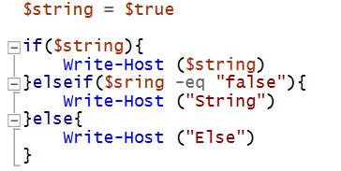

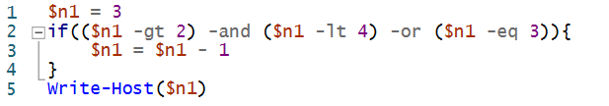

Review Exercises II
Read the code and determine what the output will be.
Example Code
Output
Level 1:
Answer
Level 2:
Answer
Level 3:
Answer

